Slide 1
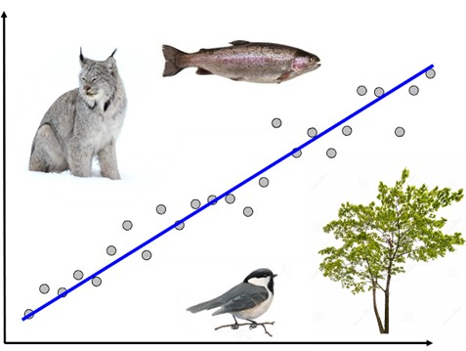
NRC 290b Introduction to Quantitative Ecology Week 13 & 14 – Final Project
Meg Graham MacLean, PhD
Department of Environmental Conservation
mgmaclean@umass.edu
2019 - Fall

Slide 2
Final 2 weeks
This week:
Monday
Making a plan for your project – SNOW DAY!!
Wednesday
Making a plan
SRTIs
Group time to work on project
Next week:
Monday
More group time and prep for group presentations
Wednesday
Group presentations

Slide 3
Final Project
Let’s practice with some real data!
Two parts to the final project:
Presentations (30% of grade)
7 minutes to present preliminary data/results, 3 for questions/suggestions for improvement
Wednesday, December 11th, in class, slides due the night before!
Report (70% of grade)
Structured after a peer-reviewed scientific journal article
Must have 2+ primary literature sources (beyond the one I gave you!)
Plus .R script
Due by 11:55pm on Wednesday, December 18th

Slide 4
By midnight tonight (worth 5pts):
Send me your itemized and dated (rough) plan for completing your project with the task lead for each task
Please evenly distribute leadership!
Example:
Task | Completed on | Task lead | Task team members
Design and write out ecological question, H₀, and H₁ | Friday (12/6) | Tucker | Josie
Start .R script with clear comments and structure | Wednesday (12/4) | Prof M
Write code to complete t-test | Friday (12/6) | Josie | Prof M, Loki
…

Slide 5
SRTIs – 15 mins
https://www.umass.edu/oapa/student-response-instruction-srti

Slide 6
Week 13 – Reporting Results
Part II - Wednesday

